Slide 1


CMR TECHNICAL CAMPUS UGC(AUTONOMOUS) Kandlakoya, Medchal Road, Hyderabad-501401, Telangana Department of Computer Science and Engineering Mini Project On AN INTELLIGENT DATA-DRIVEN MODEL TO SECURE INTRAVEHICLE COMMUNICATIONS BASED ON MACHINE LEARNING BATCH NO : 05
PROJECT GUIDE:
Mrs.G.Kalpana Devi
Assistant Professor,CSE Department
BATCH MEMBERS:
T.Sai Prasanna 217R1A0559
V.Sai Prathap 217R1A0564

Slide 2
CONTENTS
Abstract
Introduction
Existing system
Disadvantages of existing system
Proposed system
Advantages of proposed system
Hardware and software requirements
Novelty
Architecture
Modules
UML Diagrams
Sample Code
Result
Conclusion
Future Scope
References
Github Link

Slide 3
ABSTRACT
The paper addresses cyberattacks in electric vehicles by proposing a secured and intelligent framework to prevent hacker penetration.
The model uses an improved support vector machine (SVM) for anomaly detection, relying on the Controller Area Network (CAN) bus protocol.
A new Social Spider Optimization (SSO) algorithm is developed to enhance the model’s ability to detect and avoid malicious attacks, reinforcing the training process offline.
Simulation results on real-world datasets demonstrate the model's high performance, reliability, and effectiveness in protecting against denial-of-service (DoS) attacks in electric vehicles.

Slide 4
INTRODUCTION
Securing intravehicle communication is vital for electric vehicle safety due to rising cyber threats.
Traditional methods, such as using ECUs and CAN bus protocols, are effective but susceptible to modern cyberattacks.
The research proposes a machine learning-based anomaly detection system to strengthen vehicle cybersecurity.
It analyzes CAN bus data to detect irregular patterns in real-time,support Vector Machines (SVM) are employed for anomaly detection.
The model’s accuracy is enhanced through the use of the Social Spider Optimization (SSO) algorithm.
The system is trained on real-world datasets, enabling it to differentiate between normal and malicious communications.

Slide 5
EXISTING SYSTEM
The CAN protocol is widely used in electric vehicles due to its low cost and high component compatibility, but it lacks confidentiality and authentication, making it vulnerable to attacks.
In a wired attack, hackers can access the CAN bus through the OBD-II maintenance port, typically located under the steering wheel, allowing them to read and write CAN traffic using tools like the ECOM API.
In wireless attacks, hackers target the ECU without using the OBD-II port, often by connecting the vehicle to a malicious Wi-Fi hotspot or exploiting keyless entry systems through reverse-engineering the transponder's security mechanisms.
Weaknesses in vehicle security also exist in areas like the design of ciphers, authentication protocols, and their implementation.

Slide 6
DISADVANTAGES OF EXISTING SYSTEM
Less accuracy
Low Efficiency

Slide 7
PROPOSED SYSTEM
The performance of the proposed anomaly detection model is evaluated using experimental data from an electric car, specifically focusing on the significance of denial-of-service (DoS) attacks within vehicle intra-communication systems.
DoS attacks pose a serious threat as they can prevent legitimate users, such as drivers, from accessing essential services, potentially leading to severe accidents or vehicle malfunctions.
Examples of DoS attacks include actions like activating brakes, turning the steering wheel unexpectedly, shutting off the engine, or unlocking doors while the vehicle is in motion.
A complete trace analysis of the captured traffic log confirms that a 10-minute drive captures most periodic CAN messages, enabling the model to effectively distinguish between normal and anomalous behaviors during the testing phase, which includes various driving conditions such as acceleration, braking, and parking maneuvers.

Slide 8
ADVANTAGES OF PROPOSED SYSTEM
High accuracy
High efficiency

Slide 9

REQUIREMENTS SPECIFICATION
Hardware requirements :
Processor : i5
Hard disk : minimum of 40 GB
RAM : minimum of 4 GB
Software requirements :
Operating System : Windows 10
Coding Language : Python 3.7v

Slide 10
NOVELTY
The project presents an innovative method for securing intravehicle communication by combining machine learning with advanced optimization techniques, specifically through an enhanced support vector machine for anomaly detection.
The model utilizes a novel Social Spider Optimization (SSO) algorithm, enabling accurate and rapid identification of cyber threats, including denial-of-service (DoS) attacks.
A significant aspect of the system is its dual-stage optimization process, which enhances its ability to adaptively learn from real-world CAN bus data.
This approach offers a robust defense mechanism that substantially increases security and reliability compared to traditional methods focused solely on the inherent features of the CAN bus protocol.

Slide 11
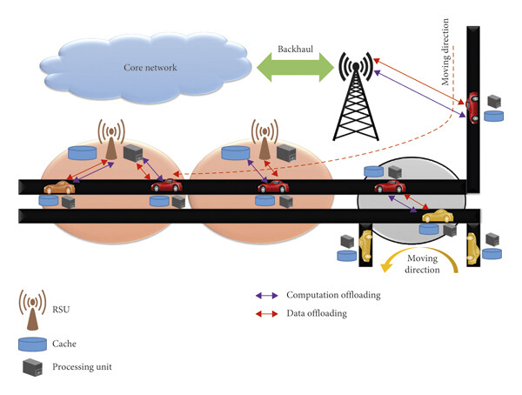
ARCHITECTURE

Slide 12
MODULES
To Implement this project we have designed following modules:
Upload CAN Bus Dataset’ button and upload dataset
Run KNN Algorithm To Detect Anomaly’ button to build KNN classifier train model to detect anomaly and evaluate its performance based on 4 indices
Run Conventional SVM To detect Anomaly’ button to evaluate conventional SVM performance.
Propose SSO with SVM To detect Anomaly’ button to run propose SSO with SVM classifier and evaluate its performance.
Classifiers Performance Graph’ button to get performance graph between all classifiers
Predict Anomaly from Test Data’ button to upload test data and predict it label.

Slide 13
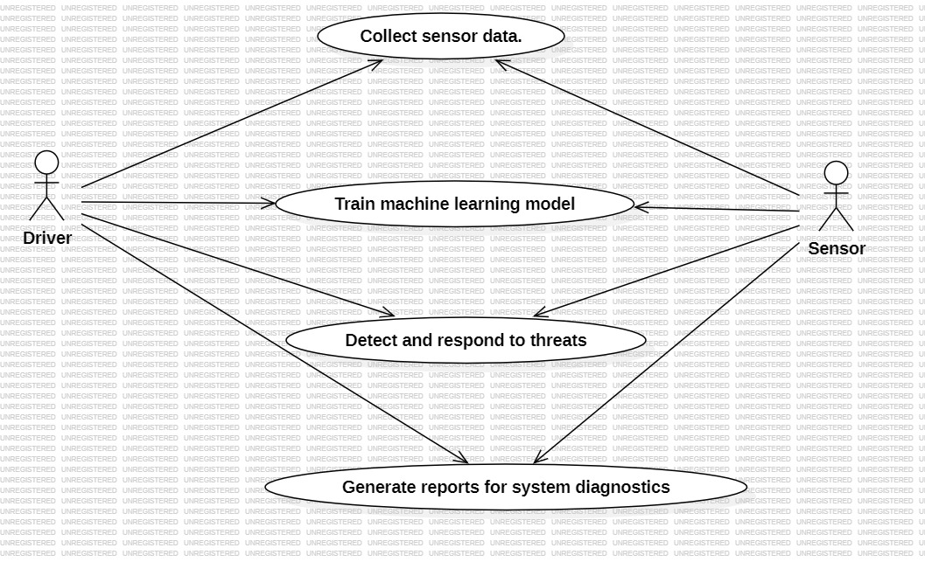
UML DIAGRAMS
USE CASE DIAGRAM

Slide 14
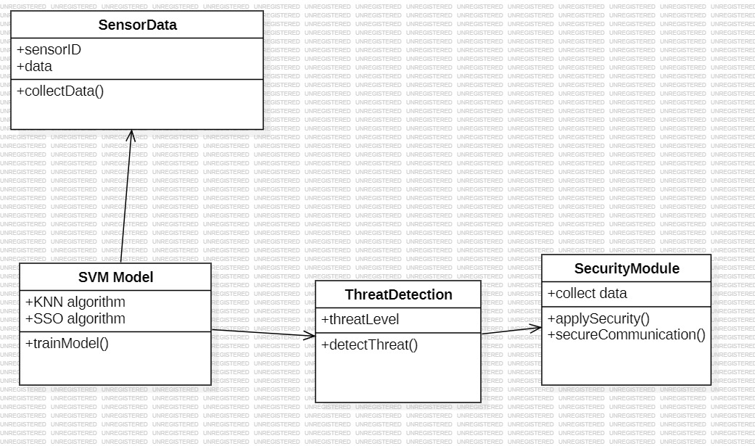


CLASS DIAGRAM

Slide 15
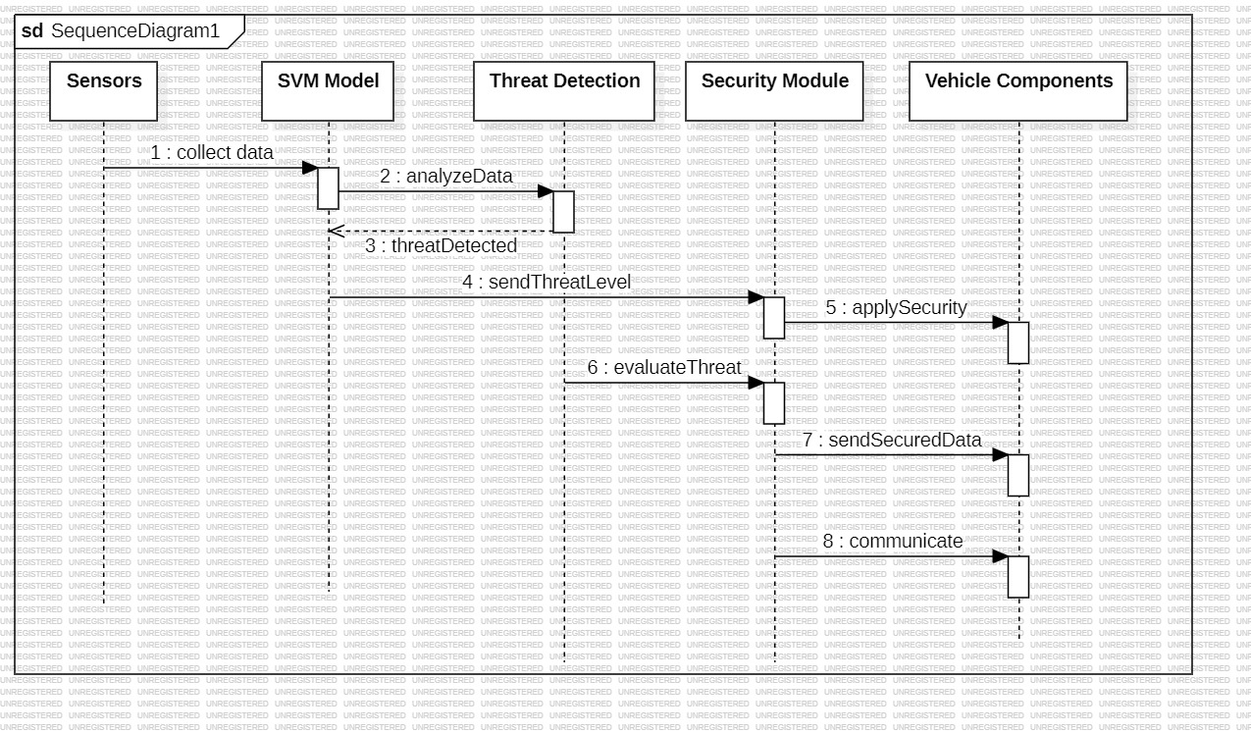
SEQUENCE DIAGRAM

Slide 16

SAMPLE CODE

Slide 17
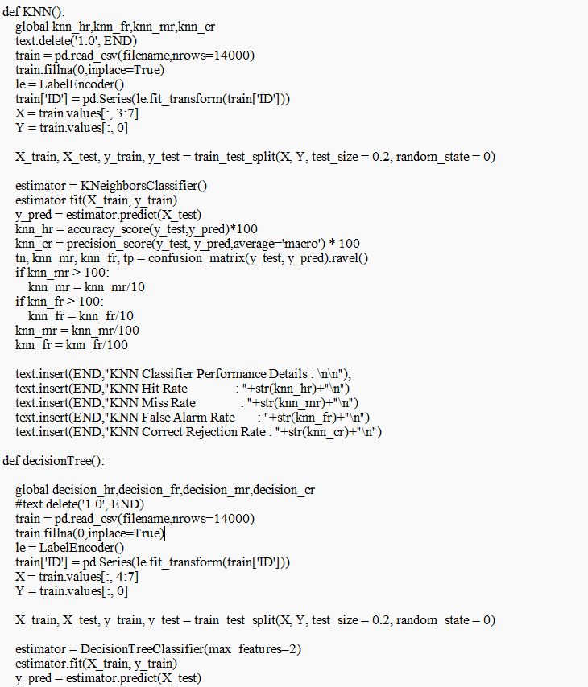

Slide 18
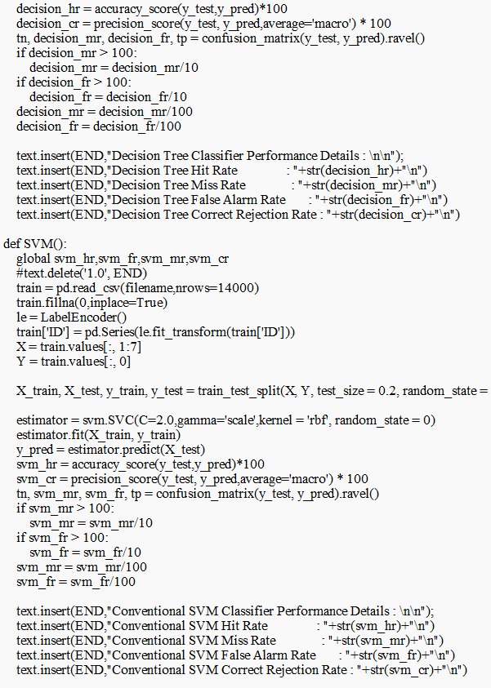

Slide 19
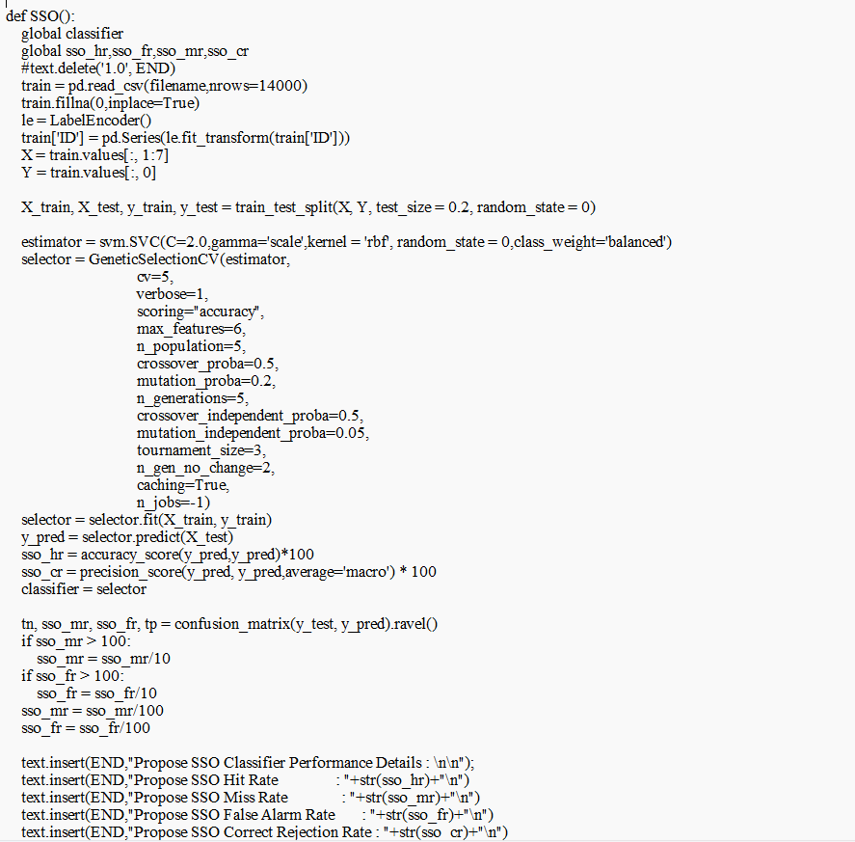

Slide 20
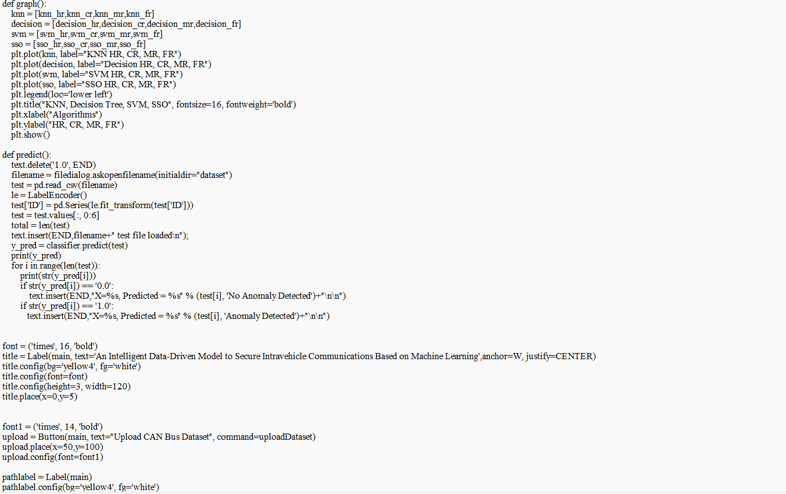

Slide 21
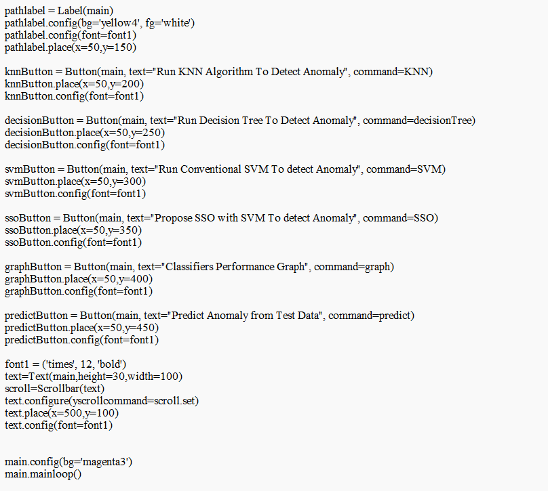

Slide 22
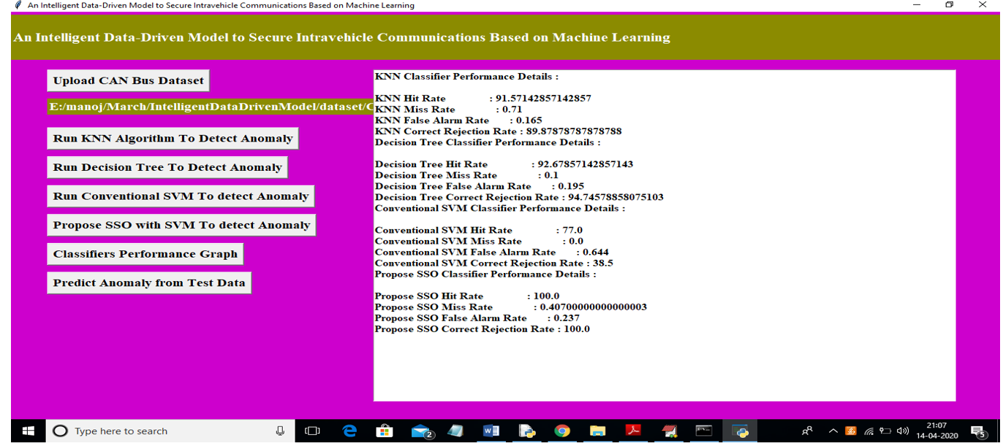
RESULT

Slide 23
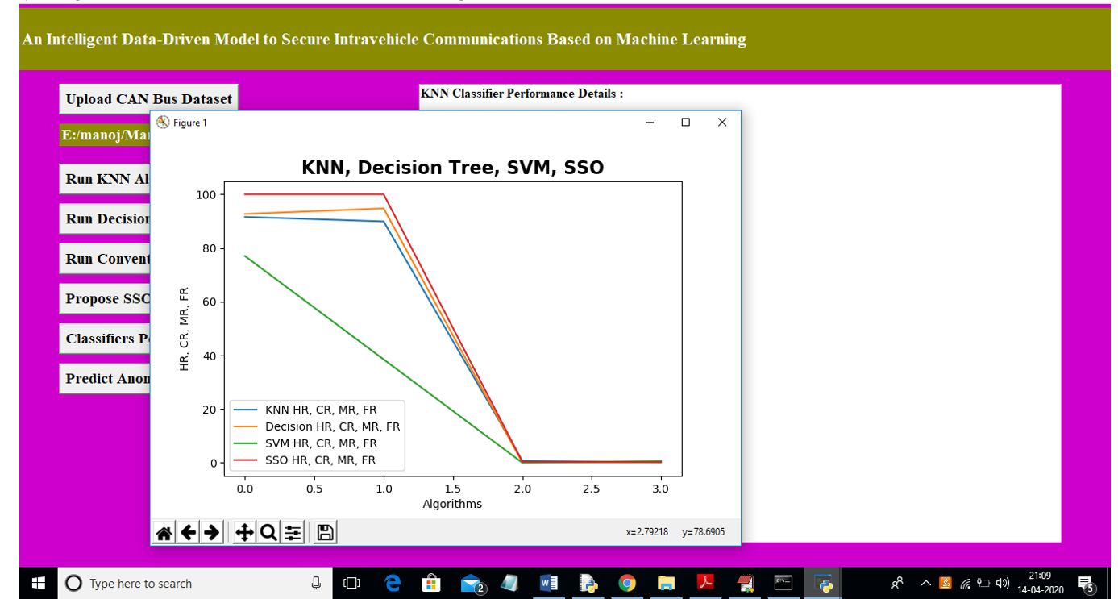

Slide 24
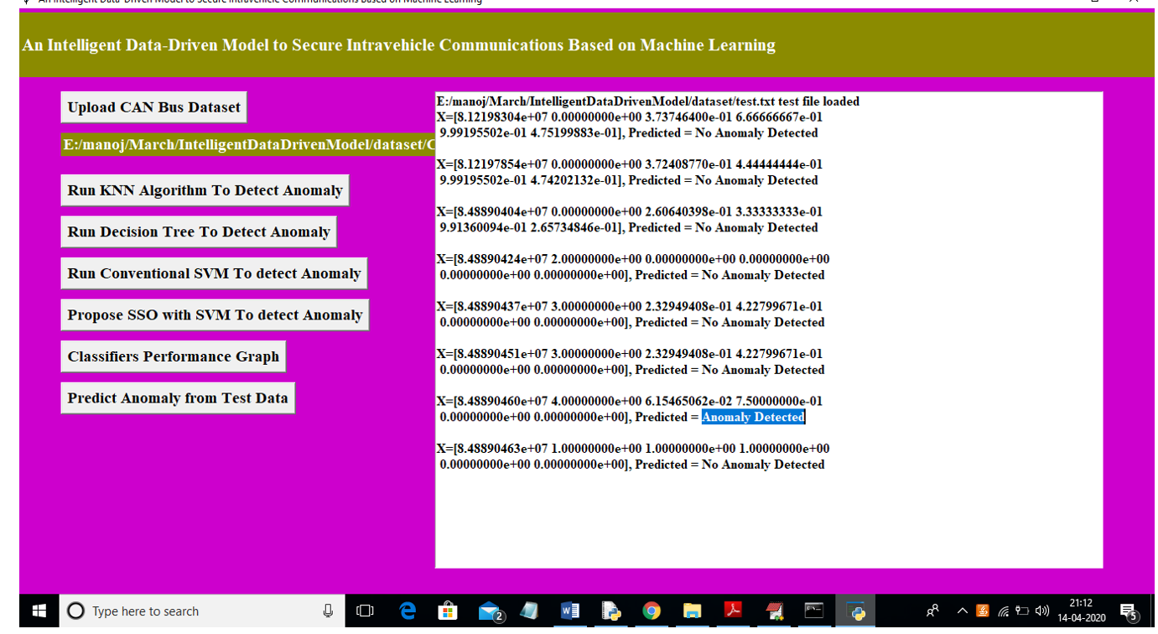

Slide 25
CONCLUSION
The proposed intelligent anomaly detection model effectively identifies cyberattacks in electric vehicles by using an improved support vector machine (SVM) enhanced by the modified SSO algorithm to differentiate between malicious and trusted messages within the CAN protocol.
Experimental results show significant improvements in detection performance, reflected by higher hit rates (HR%) and false rejection rates (FR%), indicating robust true positive and true negative rates, along with low misclassification rates (MR%) and computational resource consumption rates (CR%).
The model demonstrates superior computational efficiency and accuracy compared to traditional security methods, making it a reliable solution for intravehicle communication security.

Slide 26
FUTURE SCOPE
Expand detection capabilities to cover a wider range of cyberattacks (e.g., man-in-the-middle, spoofing).
Optimize the model for real-time attack detection with low-latency responses.
Extend the model to support additional vehicle communication protocols (e.g., FlexRay, LIN).
Scale the model for use in autonomous and connected vehicle systems with high data throughput.
Develop cloud-based security systems for centralized fleet monitoring and anomaly detection.
Integrate the model with IoT networks and smart city infrastructures.
Incorporate advanced AI techniques, such as deep learning, to enhance attack detection capabilities.

Slide 27
REFERENCES
[1] B. Mohandes, R. Al Hammadi, W. Sanusi, T. Mezher, S. El Khatib, “Advancing cyber–physical sustainability through integrated analysis of smart power systems: A case study on electric vehicles”, International Journal of Critical Infrastructure Protection, vol. 23, pp. 33-48, 2018.
[2] G. Loukas, E. Karapistoli, E. Panaousis, P. Sarigiannidis, T. Vuong, A taxonomy and survey of cyber-physical intrusion detection approaches for vehicles, Ad Hoc Networks, vol. 84, pp. 124-147, 2019.

Slide 28
GITHUB LINK
https://github.com/Sai-prasanna559/IV-Year-CSE-A-Mini-Project-batch-5

Slide 29
THANK YOU

